Slide 1
Maths Workshop
Year 5 and 6
Teachers:
Year 5
Rebecca Steel
Fiona McDonald
Oliver Finegold
Teachers:
Year 6
Alison Clark
Laura McPherson
Samantha Beeton

Slide 2
Aims
Share what lessons are like in school
Share the idea of fluency first then building on this with reasoning
Share how we use concrete, pictorial, abstract (CPA) to build understanding
Supporting Children at Home – homework/rocket card
Year 6 SATs
National Curriculum Levels

Slide 3
Welcome to Years 5 and 6
The Maths Curriculum
We follow White Rose – Mastery approach
Ensures confidence in fluency then challenges with reasoning
Concrete Resources
Begin with concrete resources such as diennes and counters
Move towards pictorials representation – may be the same as the concrete or could be other things such as packets of pencils
When secure, move onto abstract methods
People often think older children don’t use resources so much but they do – helps develop a secure understanding of concepts
Maths Vocabulary
A continued focus on Maths language. This should now be more familiar and we will continue to embed it to further support reasoning and problem solving.

Slide 4
Welcome to Years 5 and 6
Facts fluency
Big emphasis on knowing key numbers facts – this supports written calculation and is essential to become confident learners
Key facts they need to know:
Number bonds – all to 20, 100 and links to 1000
Times tables up to 12x12
Homework – year 5
Homework is all based on the rocket cards which have been uploaded to Google Classroom
All based on mental Maths targets previously taught therefore children should have some confidence in them
Written homework and sometimes a suggestion of a website or an activity on Mathletics
This is key to support children in being able to access all areas of Maths.
Homework – year 6
Homework book linked to learning in school
Compulsory – kept in to complete – prepare them for secondary school

Slide 5
Welcome to Years 5 and 6
Mastering Number at KS2
Year 5
New program to enhance children’s understanding of multiplication and division.
Daily 10 minutes
Having a positive impact so far

Slide 6
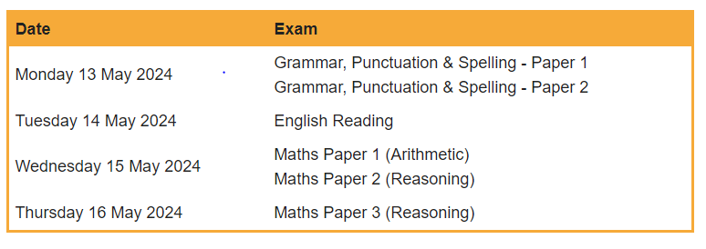
Welcome to Years 5 and 6
SATs
In May for year 6

Slide 7
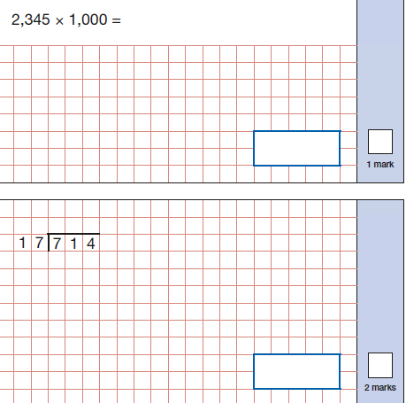
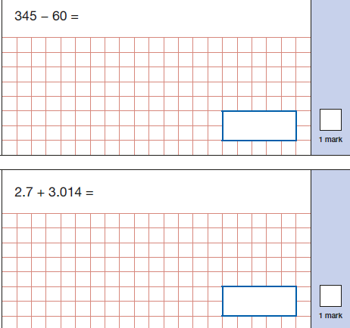
Welcome to Years 5 and 6
SATs
Arithmetic – calculating using mental strategies and written methods – use of all 4 operations, fractions, decimals.

Slide 8
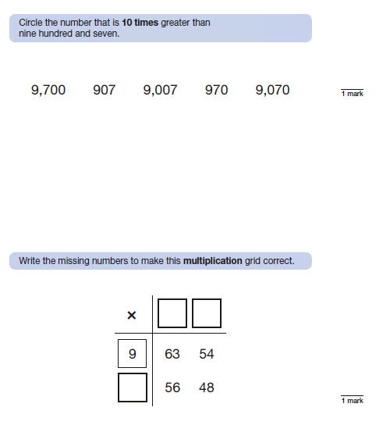
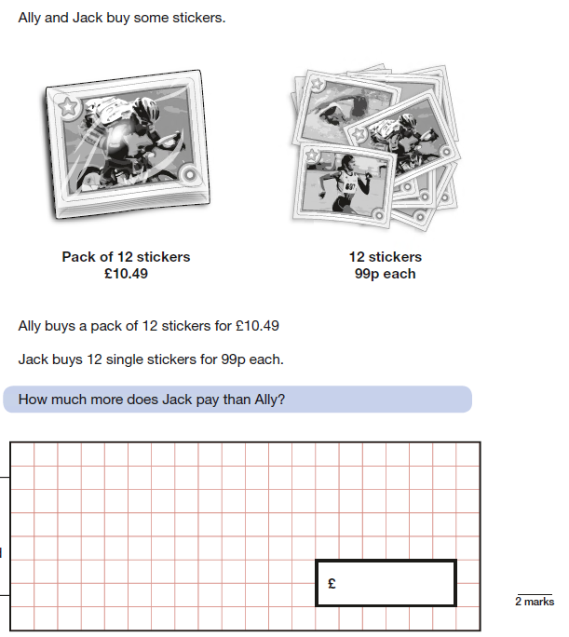
Welcome to Years 5 and 6
SATs
Reasoning – 2 papers. The second one is NOT harder than the first.
Using and applying what they have learnt.

Slide 9
National Curriculum Levels
Children are assessed based on their year group.
Their level begins with the year group number – 5 or 6 then has pairs of letter.
WT – working towards the expected level
ME – Meeting the expected level
EE – Exceeding the expected level
If they are working considerably below their year group’s level, they may be assessed against lower year group’s expectations so they could end the year as 4ME or 3WT for example.
At parents evening we will discuss if they are currently on track for meeting expectations etc but you will only get an assessed level in the end of year report

Slide 10
Questions – where can you find the answers?
School Website
Parents evenings
Online Resources. Topmarks is also a good website for Maths games
Resources you can take away: rocket card for the appropriate year group, example arithmetic and reasoning papers.

