Slide 1

Maths Workshop
Year 3 and 4
Teachers:
Year 3
Najma Ibrahim
Lydia Saunders
Teachers:
Year 3/4
Sheryl Burton/ Leanne Witchell
Teachers:
Year 4
Ghislaine Seaton
Josie Blake/Vikki Gale

Slide 2
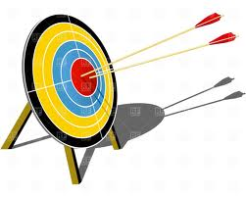
Aims
Share what lessons are like in school
Share the idea of fluency first then building on this with reasoning
Share how we use concrete, pictorial, abstract (CPA) to build understanding
Supporting Children at Home – homework/rocket card
Times Tables check
National Curriculum Levels

Slide 3

Welcome to Years 3 and 4
The Maths Curriculum
We follow White Rose – Mastery approach – share website
Ensures confidence in fluency then challenges with reasoning
Concrete Resources
Begin with concrete resources such as diennes and counters
Move towards pictorial representation – may be the same as the concrete or could be other things such as packets of pencils
When secure, move onto abstract methods
Maths Vocabulary
A bigger focus on Maths language. This should now be more familiar but new words may be introduced e.g. addend, subtrahend, product, quotient – supports children when solving problems

Slide 4
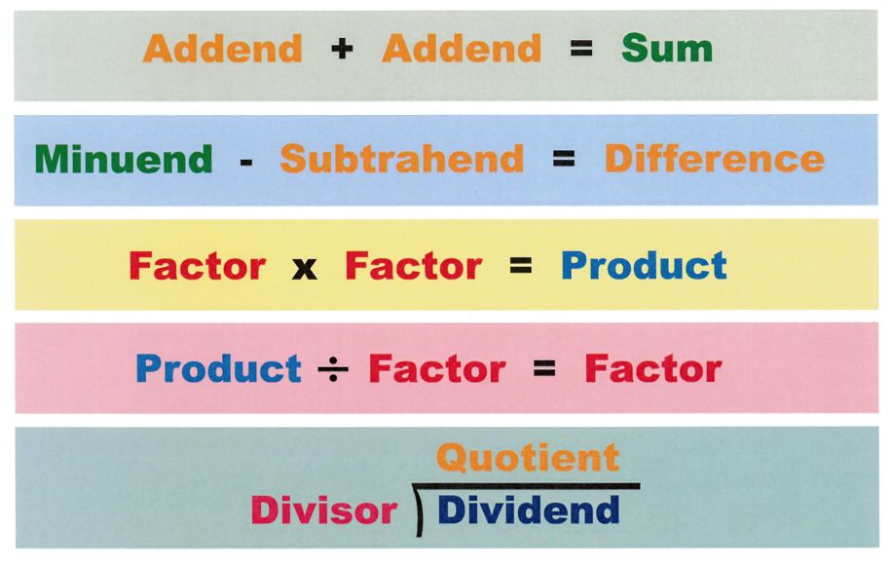

Slide 5
Welcome to Years 3 and 4
Facts fluency
Big emphasis on knowing key numbers facts – this supports written calculation and is essential to become confident learners
Key facts they need to know:
Number bonds – all to 20
Times tables – year 3 need to know 2, 5, 10, 3, 4 and 8. Year 4 need to know them all up to 12x12
Homework
Homework is all based on the rocket cards which have been uploaded to Google Classroom
All based on mental Maths targets previously taught therefore children should have some confidence in them
Written homework and sometimes a suggestion of a website or an activity on Mathletics
This is key to support children in being able to access all areas of Maths.

Slide 6
Welcome to Years 3 and 4
Times tables check
End of year 4
All times tables up to 12x12
On the computer or ipad and children have 6 seconds to answer.
Idea is to ensure children are ready for years 5 and 6 and so we can support them quickly at the start of year 5 if they have not achieved them all to stop them falling further behind
Throughout years 3 and 4, the more you work on times tables with your children the better!
TTRS rewards in school so this is a great way to develop their recall. Sound check mimics the test.
It is scheduled for the 2 weeks beginning 2nd June 2025

Slide 7
Welcome to Years 3 and 4
Mastering Number at KS2
Year 4
New program to enhance children’s understanding of multiplication and division.
Daily 10 minutes
Having a positive impact so far

Slide 8

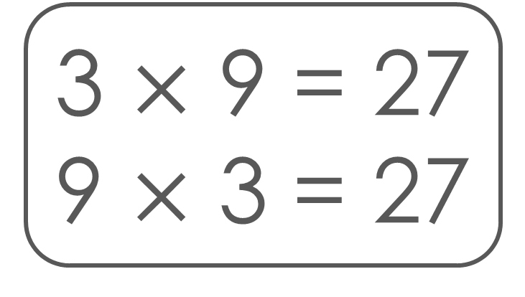
GOING FOR GOLD
Let’s keep working on this ‘Going for Gold’ fact.
Focus fact
Focus fact
3 $×$ 9 = 27
9 $×$ 3 = 27

Slide 9
Understand

Slide 10

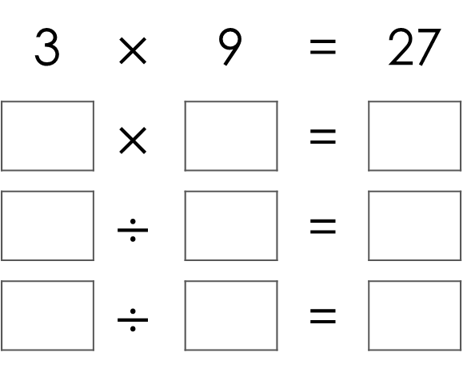
What other facts can Cal write using the same numbers?
3 | $$×$$ | 9 | = | 27
 | $$×$$ |  | =
 | $$÷$$ |  | =
 | $$÷$$ |  | =
9
3
27
27
3
9
27
9
3

Slide 11



Mo knows the product of 3 and 9 is 3 less than the product of 3 and 10. Explain how the arrays show this.
10
30
3
3 | $×$ | 10
9
27
3
3 | $×$ | 9

Slide 12

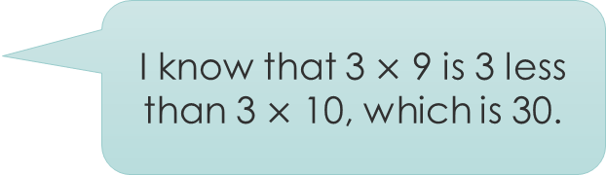
The 1s digit for the product of 3 and 9 is 7.
How does the representation help to show this?
I know that 3 $×$ 9 is 3 less than 3 $×$ 10, which is 30.
10 subtract 3 is 7, so
30 subtract 3 is 27.
Cal
Mo
0
27
30

Slide 13
National Curriculum Levels
Children are assessed based on their year group.
Their level begins with the year group number – 3 or 4 then has pairs of letter.
WT – working towards the expected level
ME – Meeting the expected level
EE – Exceeding the expected level
If they are working considerably below their year group’s level, they may be assessed against lower year group’s expectations so they could end the year as 2ME or 1WT for example.
At parents evening we will discuss if they are currently on track for meeting expectations etc but you will only get an assessed level in the end of year report

Slide 14

Questions – where can you find the answers?
School Website
Parents evenings
Online Resources. TTRS as much as possible! Topmarks is also a good website for Maths games
Resources you can take away: rocket card for the appropriate year group, times tables booklet.

