Slide 1
Times tables
Parent Workshop
Supporting your child at home

Slide 2
Aims
National expectations and wider importance.
Year 4 times tables check.
Cognitive Load Theory.
The teaching approach at school.
Supporting pupils at home.
Useful resources.
Questions.

Slide 3
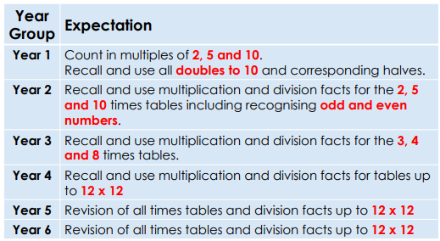
National Expectations

Slide 4
The Multiplication Tables Check (MTC)
The Multiplication Tables Check (MTC) will be administered to children in Year 4, between Monday 2nd June and Friday 13th June 2025. It is a statutory assessment.
The purpose of the MTC is to determine whether Year 4 pupils can recall their multiplication tables up to 12 x 12 fluently as outlined in the National Curriculum.
There is no pass mark. The results will be used to inform us of the pupils who need further support. This may be through interventions or clubs in year 5.
Children will be tested using a computer, where they will have to answer multiplication questions against a clock. The test will last no longer than 5 minutes; children will have 6 seconds to answer each question in a series of 25.
The results will be reported to the Department of Education.
https://www.timestables.co.uk/multiplication-tables-check/ Practice website.

Slide 5
Why are times tables important?
Times tables knowledge underpins much of the primary Maths curriculum.
Mastering times tables and having the ability to quickly recall known facts is a necessary step to approaching more challenging topics as they progress through school.

Slide 6
Cognitive Load and Times tables
Cognitive Load Theory states that learners have a limited capacity in their working memory and we must not over load this.
This means that if pupils are having to work hard to recall or calculate times tables facts, they will have less capacity available to absorb new and more complex information.
Secure times tables knowledge ensures more capacity and a higher level of success when approaching new concepts in mathematics.

Slide 7
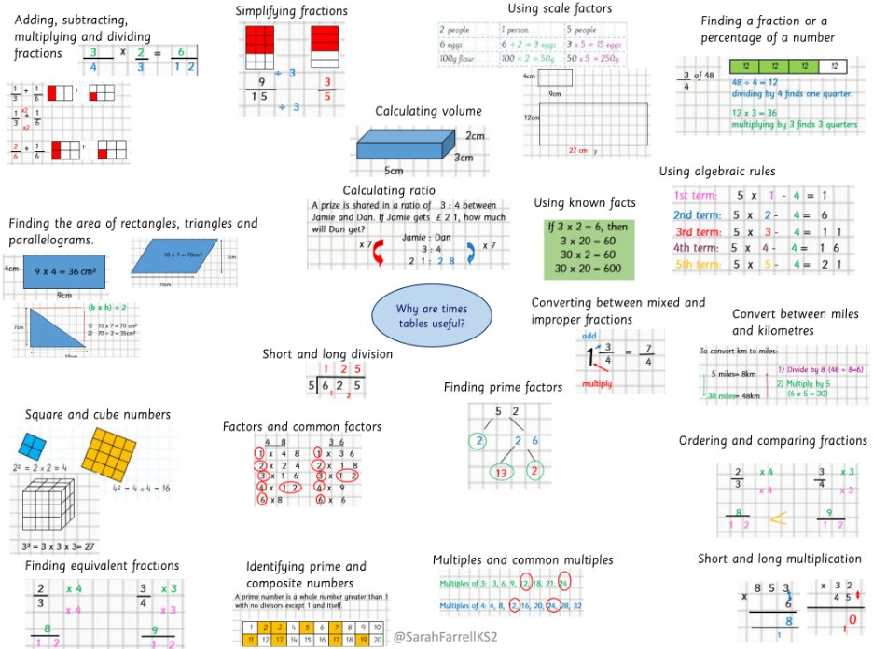
KS2 topics which require times tables knowledge.
Fractions.
Decimals.
Multiplication.
Division.
Area.
Ratio.
Square and cube numbers.
Place value.
Prime numbers.
Common multiples.
Factors.

Slide 8
How we teach times tables at Bessemer.
Times tables are taught every day for at least five minutes through Mastering Number
Times tables are part of the Maths curriculum
In addition, we aim to develop pupils number sense. This means the ability to spot patterns, use related facts to retrieve other information and be flexible with the knowledge they.
We have an optional TTRS club 3 lunchtimes per week
All pupils have access to TTRS to complete at home too
Notes:
If pupils are struggling with times tables knowledge in KS2, they face a real challenge to access the majority of the curriculum and they could be at risk of falling further behind their peers.
This issue will persist into secondary school if not addressed.

Slide 9
The Number Sense Approach
Pupils who find times tables difficult, tend to choose inefficient methods to retrieve facts. This increases cognitive load and slows the pace of learning.
E.g. 1 8 X 6
8 x 6 … (unable to recall the fact)
Begins to skip count from zero using their fingers ( 0, 8, 16 …)
They are unsure of 8 x 3 so they count in ones from 16 (16, 17, 18, 19, 20, 21, 22, 23, 24).
This issue repeats until they have a correct answer.
The number of steps increases the likelihood of making a mistake and makes a relatively simple question much more complex.

Slide 10
The Number Sense approach
By teaching patterns and exploring the relationships between different times tables and by learning all the associated division facts, we aim to equip pupils with the most efficient methods.
The order in which we teach times tables allows pupils to see the links between each times tables.

Slide 11
Strategies to remember times tables
4 times tables:
Double and double again
Multiply by 5 then subtract 1 group

Slide 12
Strategies to remember times tables
6 times tables:
Multiply by 3 then double
Multiply by 5 then add 1 group

Slide 13
Strategies to remember times tables
8 times tables:
Double, double and double again
Multiply by 5, multiply by 3 and add them

Slide 14
Strategies to remember times tables
9 times tables:
Multiply by 3 then multiply by 3 again
Multiply by 6, multiply by 3 and add them
Multiply by 10 then subtract 1 group

Slide 15
11 and 12 times tables
If pupils have a secure knowledge of the 10 and 2 times tables, they can use this to help with the 12 times tables.
E.g. 12 x 8 = (10 x 8) + (2 x 8)
80 + 16 = 96

Slide 16
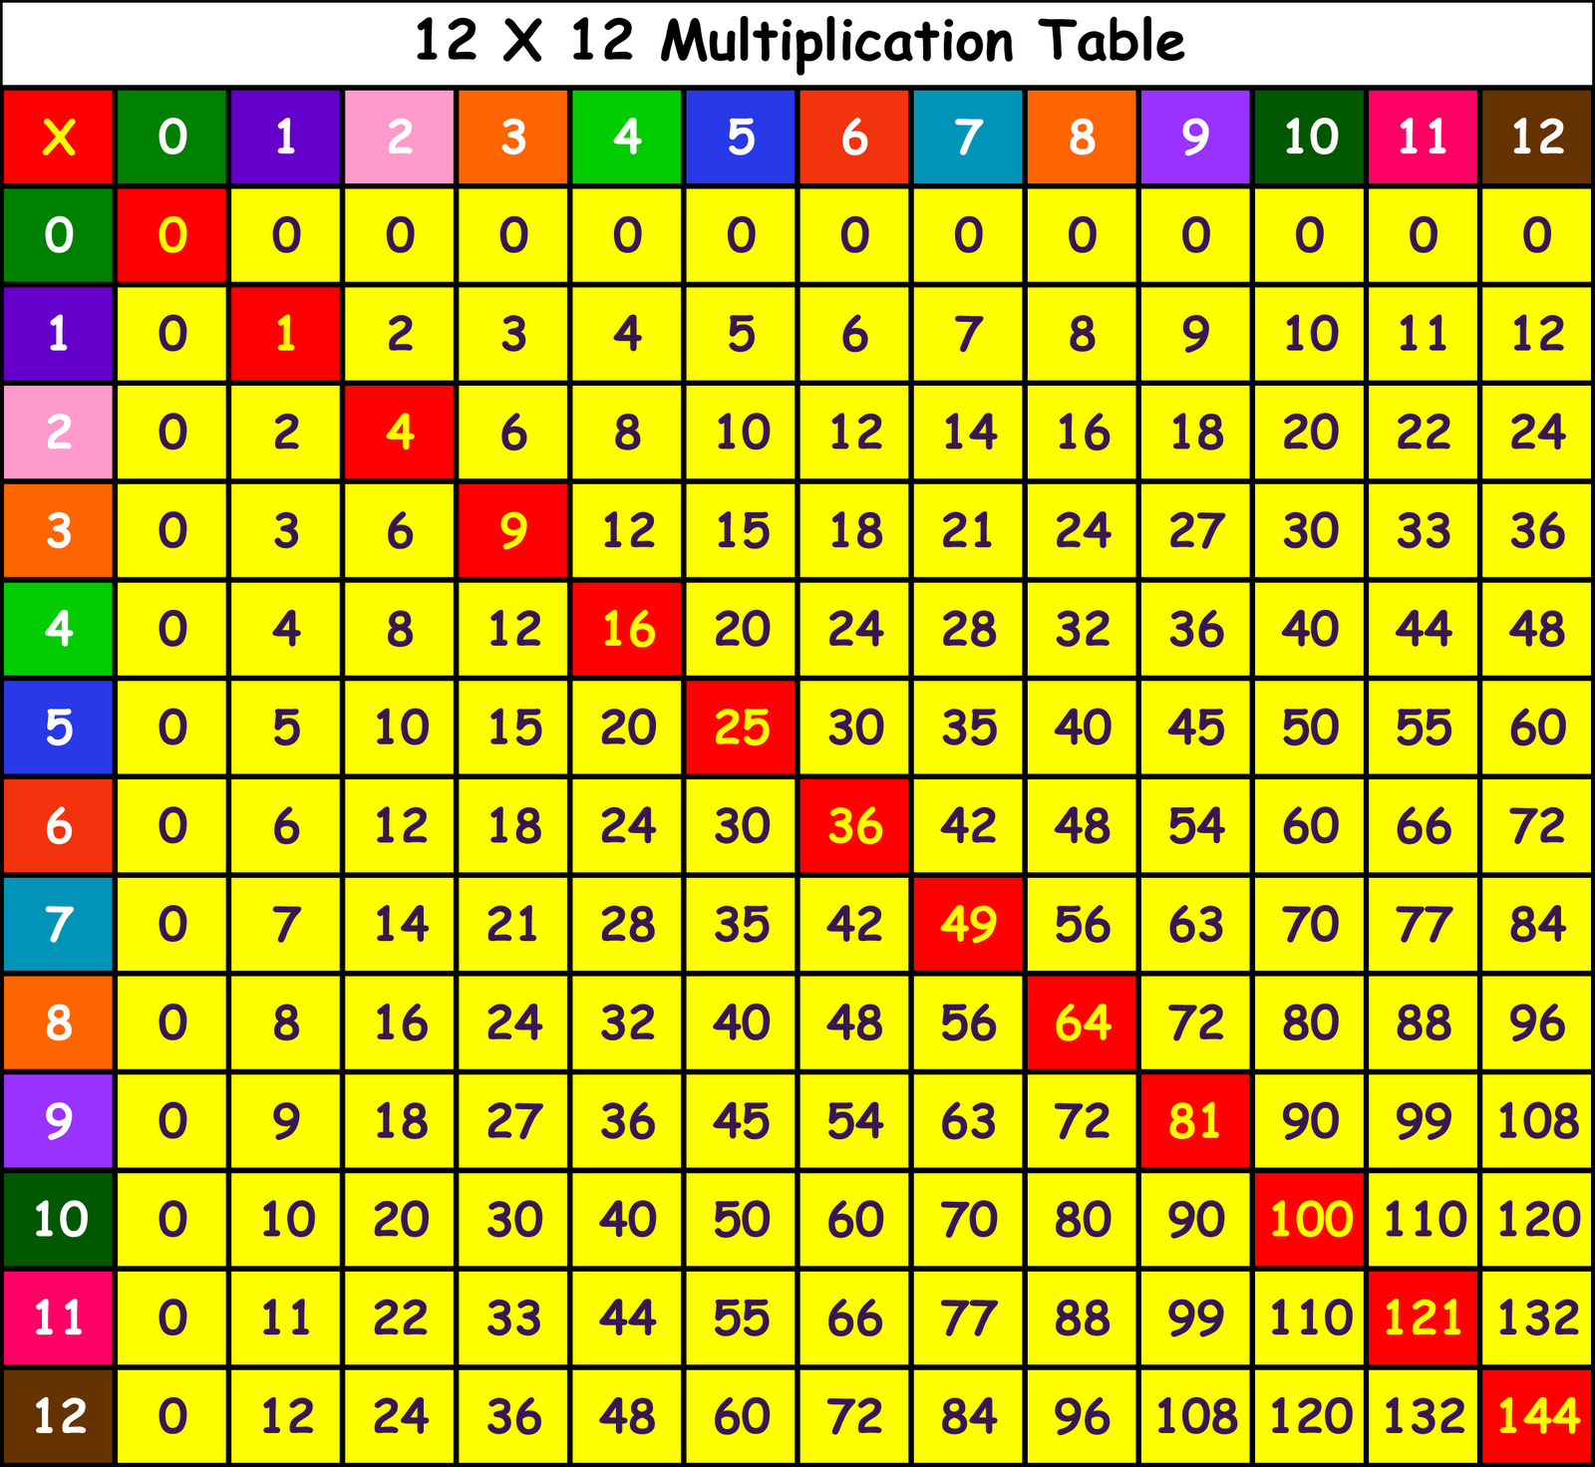
Using known facts as bridging steps.
Square numbers can be an excellent bridging step.
The 10 x tables are also excellent bridging steps.
Using this strategy helps speed pupils up and avoids over loading their working memory.
E.g. 6 x 12 = 60 + 12 = 72
Instead of 6, 12, 18, 24, 30, 36, 42, 48, 54, 60, 66, 72.
7 x 6
6 x 6 =36
36 + 6 =42

Slide 17
If you did not know what 8 x 9 is, how could you use other known facts to work it out.
8 x 10 = 80 80 – 8 = 72
8 x 8 is a square number – 64 + 8 = 72
8 x 5 = 40 x 2 = 80 (10 lots of 8) subtract 8 = 72

Slide 18
Associated facts
7 x 8 = 56
What associated facts do you know?
8 x 7 = 56
56 ÷ 8 = 7
56 ÷ 7 = 8
560 ÷ 7 = 70
70 x 80 = 5600 etc.

Slide 19
Spotting Patterns
What do you notice when you multiply an even number by 6?
6 X 2 = 12
6 X 4 = 24
6 X 6 = 36
6 X 8 = 48
6 X 10 = 60
6 X 12 = 72

Slide 20
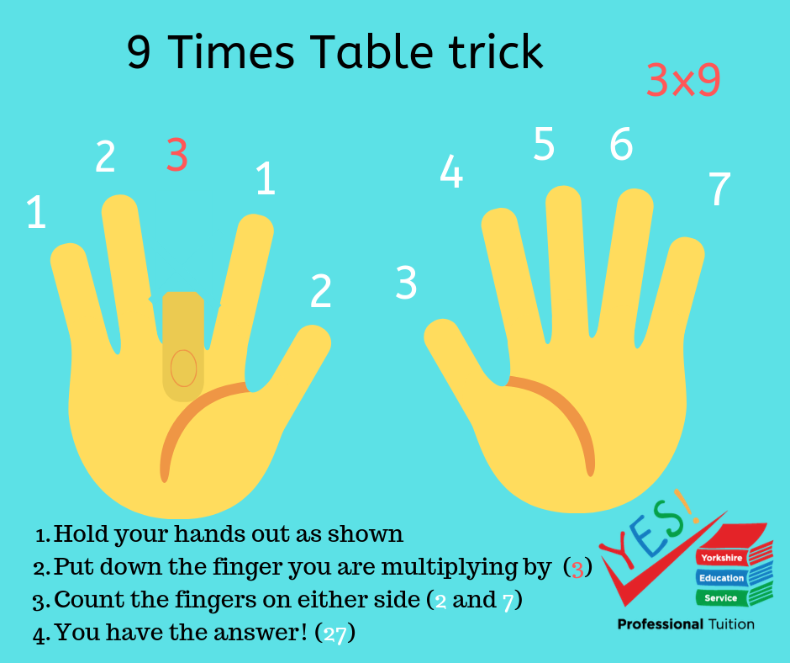
9 Times Tables on fingers

Slide 21
How can you help?
Daily practise – little and often.
Make use of apps and programmes:
TTRS
Hit the Button
https://www.timestables.co.uk/multiplication-tables-check/
Make it competitive – can they beat their own score, siblings, you etc.
All the strategies shown are used to build up fluency and get pupils to a point where they can recall all the times tables facts (12 x 12).
Share activities

Slide 22
How can you help?
Ensure pupils practise being flexible with their facts.
Skip count backwards and forwards.
Start from different points in the times tables.
Mix in related division facts.
You could use flash cards.
Vary the activities they use to practise. This will help keep it fresh and will help ensure they develop number sentence.
Ask your child about Maths lessons, about what they are studying and about their weekly times tables assessment.

Slide 23
Tricky facts
Pupils will often struggle on a few facts.
You can use TTrockstars to help spot the facts they are regularly getting wrong.
Display these facts around the house (fridge, bedroom, living room).
Revise that fact as regularly as possible over the period of a few weeks.
Intensive focus on one fact will help it stick in their memories. E.g. ask on the way to and from school, before dinner, after brushing teeth, waiting to cross the road etc.
When they get more confident revisit it less regularly but don’t forget about it.
You can also help them create a rhyme or saying to help them remember it. I ate and I ate until I was sick on the floor ( 8 x 8 is 64)
5678 Consecutive numbers - 56 = 7 x 8

Slide 24
Questions?

