Slide 1
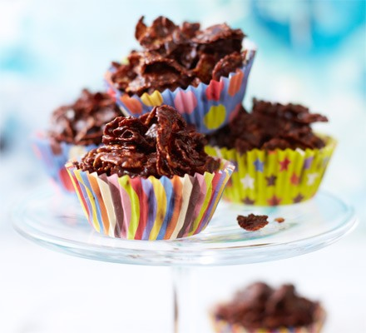
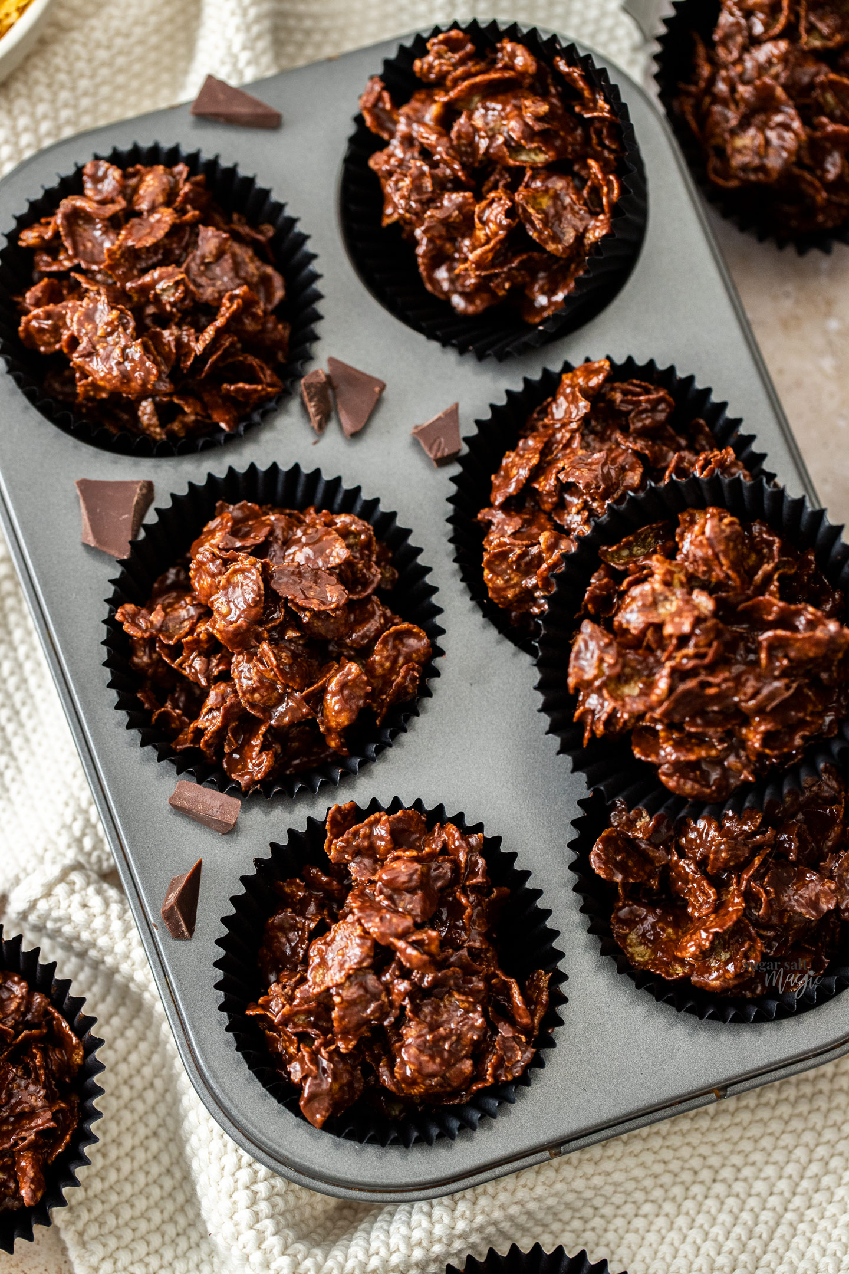
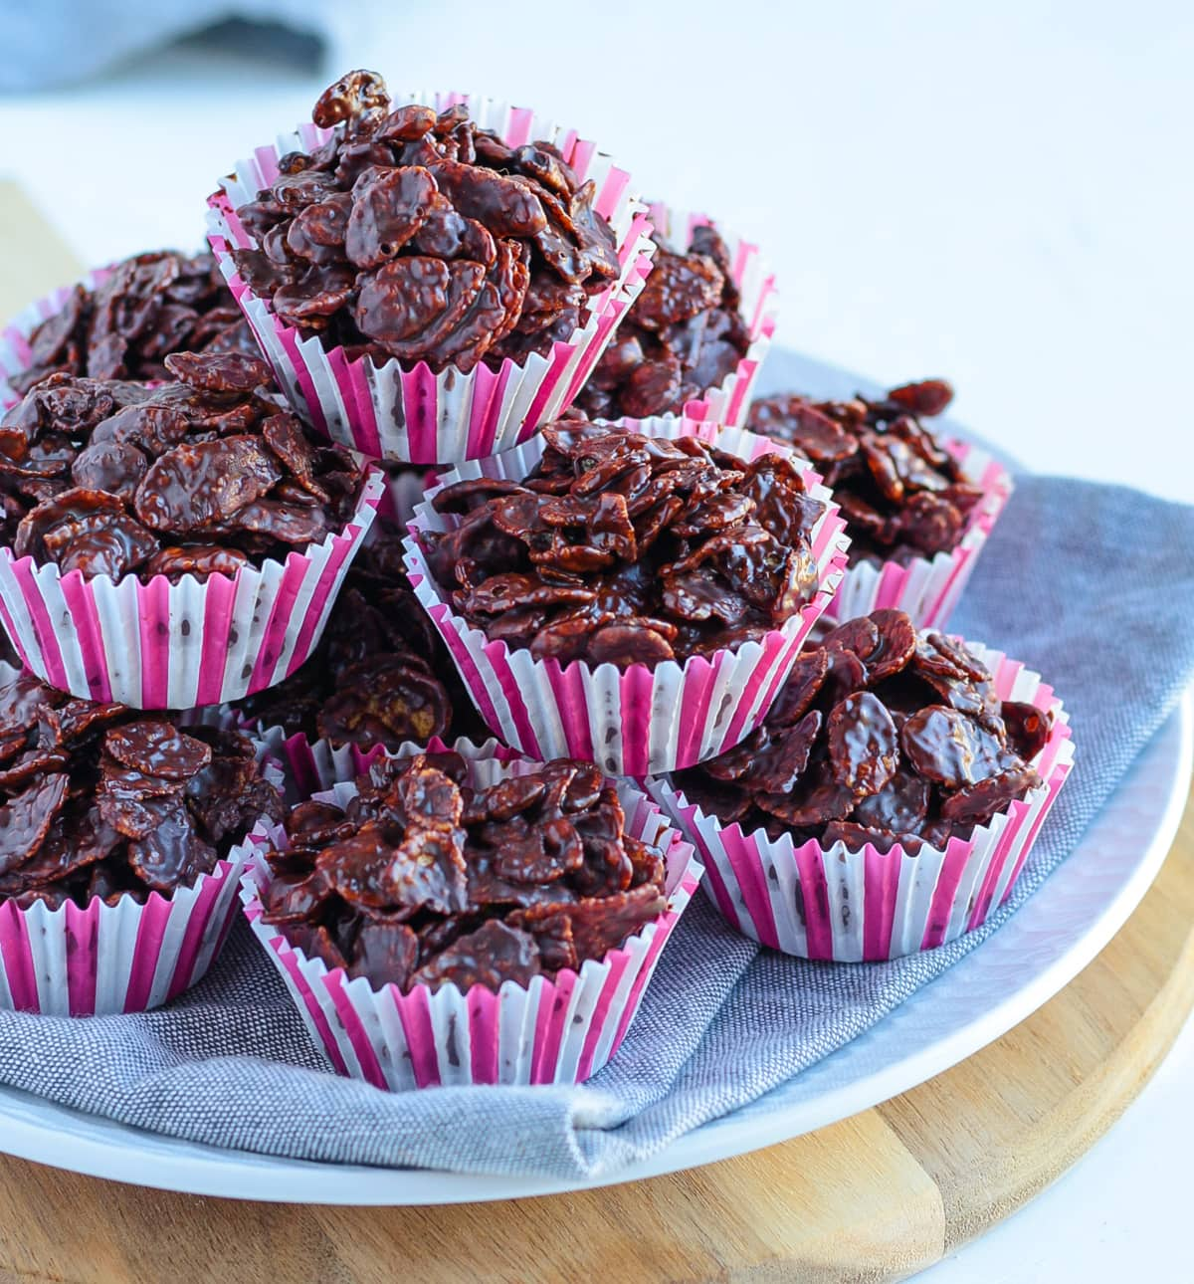
BUY IT.
TASTE IT.
LOVE IT.
REPEAT.
ONLY 75p EACH
C H O C O L A T E
C O R N
13th July, at 3:30PM outside the year 6 gate- by the nature garden.
F L A K E
N E S T S
Take a bite into our tasty, crunchy cakes, that are made with extra care, we know you too!!

