Slide 1
Cocoa keys
Samuel,Dora,Kate Jago

Slide 2
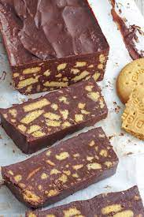
Choco Yum Yums!
Rich Tea Biscuits
Butter
Honey
Milk chocolate
Rasberries?

Slide 3
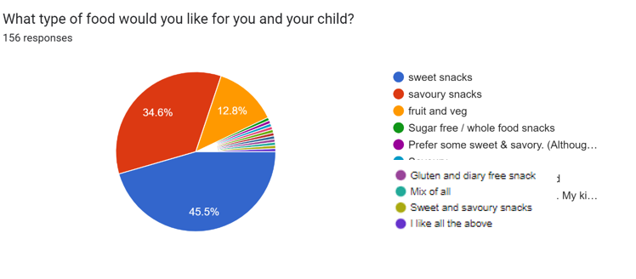
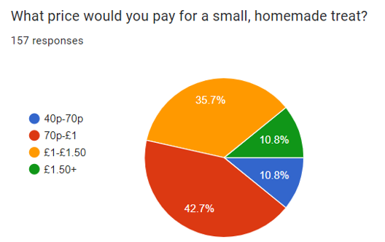
Our market research
We are making a sweet snack for the price of 75p each!

Slide 4
Sales and profits
Cost=75p
We predict that we will make a £4 profit!

Slide 5
THANK YOU FOR LISTENING

