Slide 1
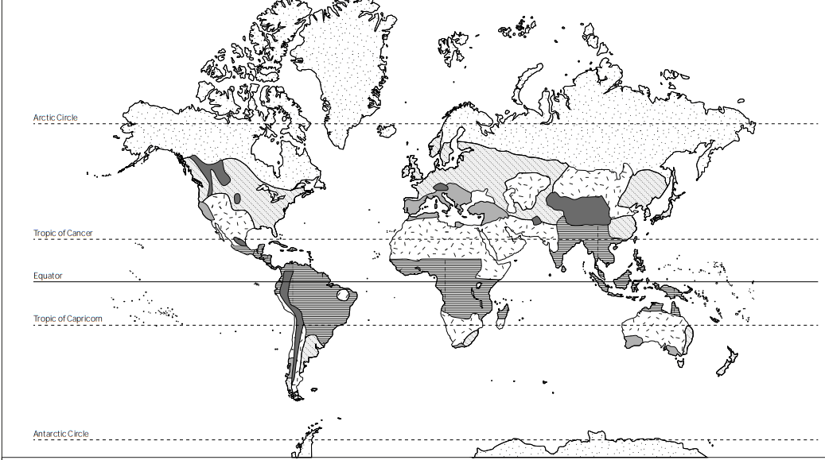
World Climate Zones
by _Matthew_____________ and _Elena______________

Slide 2
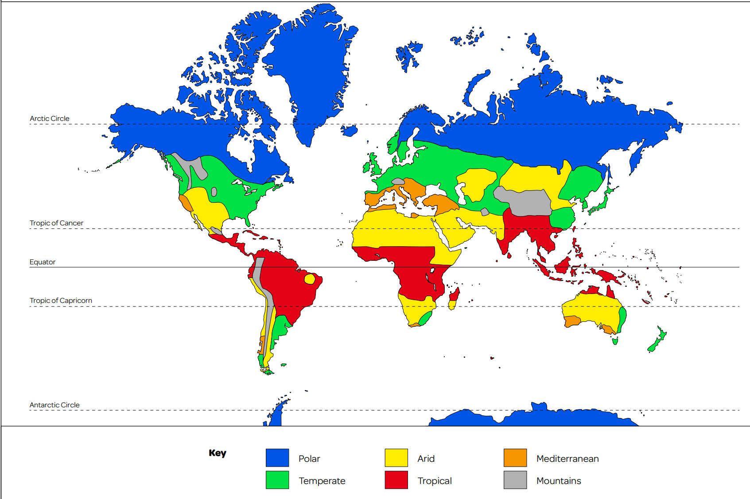





These are the main climates zones of the world! Click on each climate zone in the key to find out more!

Slide 3
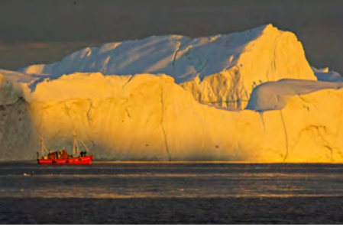
Polar Climate
Polar Climates:
Polar Climates are very cold because in winter it can drop massively it can get minus 10 or a bit lower or a bit higher.
Polar Climates are found near the artic and antartic circle close to the Artic which is the North pole and the Antartica which is the South pole.
Places in the World with Polar Climates:
Places in the world with a Polar climate are : Greenland , Antartica and the Artic.
Animals that might be found near this climate zone?
TAKE ME BACK TO THE (CLIMATE) MAP!

Slide 4
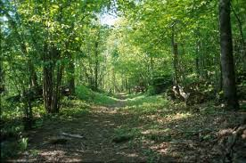
Temperate Climates
Temperate Climates:
Temperate Climates…
Temperate Climates are found near
Places in the World with a Temperate Climate:
Animals that might be found near this climate zone?
TAKE ME BACK TO THE (CLIMATE) MAP!

Slide 5
Arid/Dry Climates
Arid Climates:
Arid Climates are normally either hot or mild.
Arid Climates are found near the Equitarial line.
Places in the World with an Arid Climate:
Places near the equator and places like Egypt and places like that.
Animals that might be found near this climate zone?
The animals that live here are Camels , black widows trantaular and scorpiens Plants that are here are cactuses.
TAKE ME BACK TO THE (CLIMATE) MAP!

Slide 6
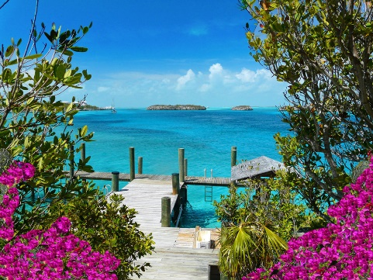
Tropical Climates
Tropical Climates:
Tropical Climates is a place where the weather is tropical warm and wet . Tropical Climates are found near the Equator Tropic of Cancer and Capricorn.
Places in the World with an Tropical Climate:
The tropical zone includes the Amazon Basin of Brazil, West Africas Congo Basin and the rainforests of Malaysia and Indonesia .Large areas of South America , Africa and Asia , located between the Tropics of Cancer and Capricorn , have a tropical climate .
Animals/Plants that might be found near this climate zone?
Parrots are found near this area and so are other animals to such as ; Monkeys , snakes , Toucan , panther and the plants that are here are Palm Trees and Vines.
TAKE ME BACK TO THE (CLIMATE) MAP!

Slide 7
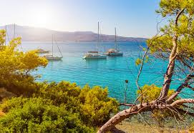
Mountainous Climates
Mountainos Climates change with ALTITUDE! There ar
Mediterranean Climates…
Meditteranean Climates are found near:
Places in the World with an Mediterranean Climate:
Animals/Plants that might be found near this climate zone?
TAKE ME BACK TO THE (CLIMATE) MAP!

