Slide 1

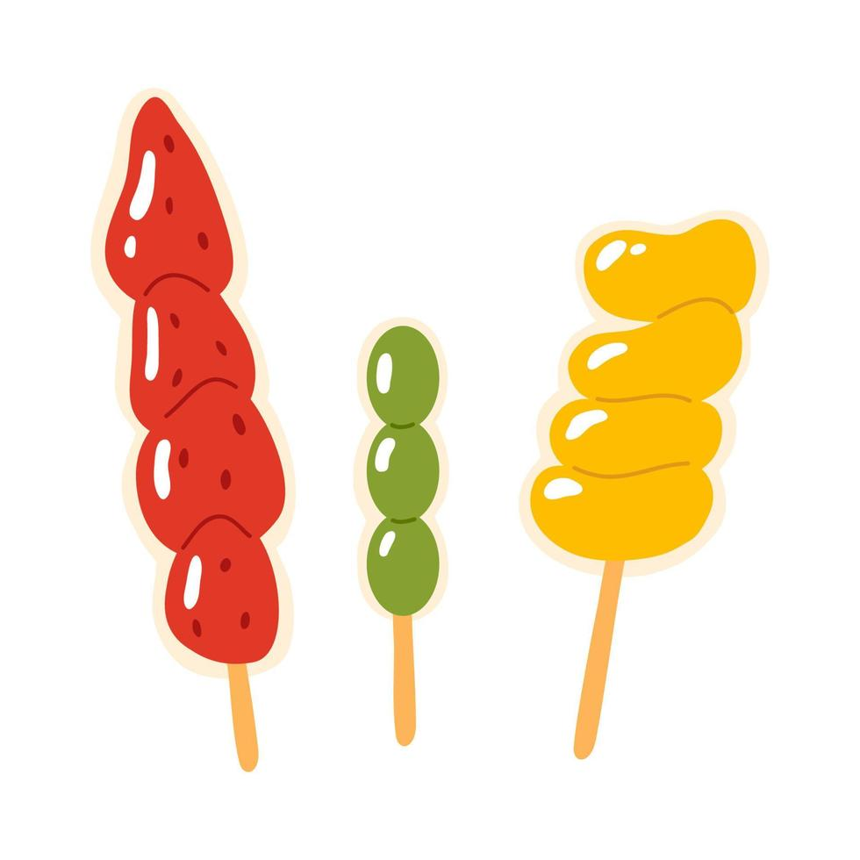
Tangy Tanghulu
A sweet sensation
Better than the rest
Only 80p
On sale Thursday 13th July 3.30 outside main school.

